Slide 1
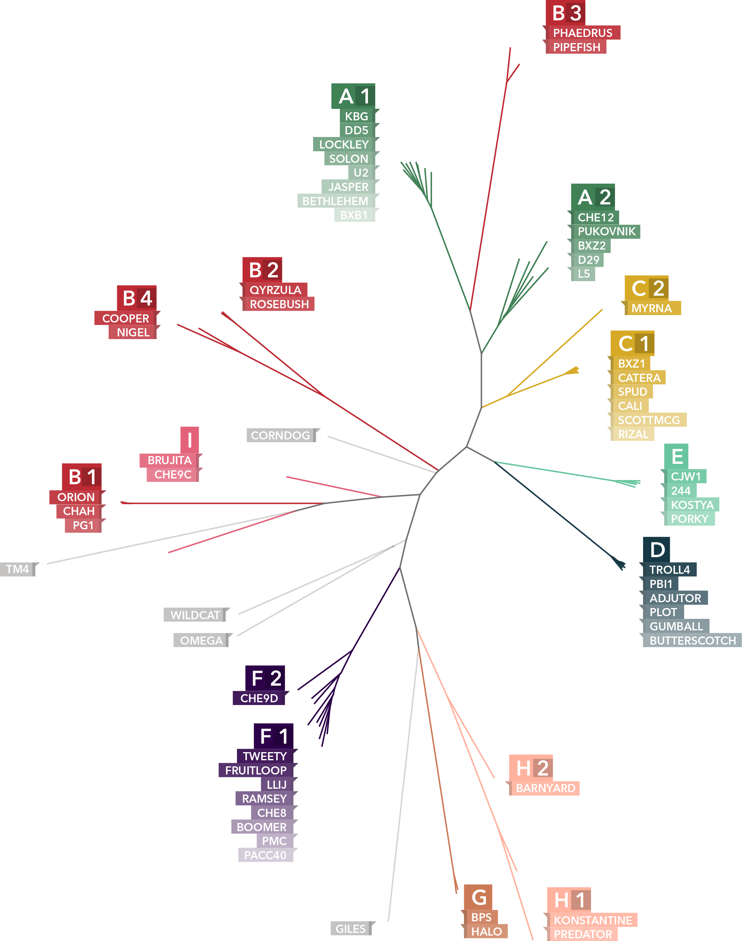
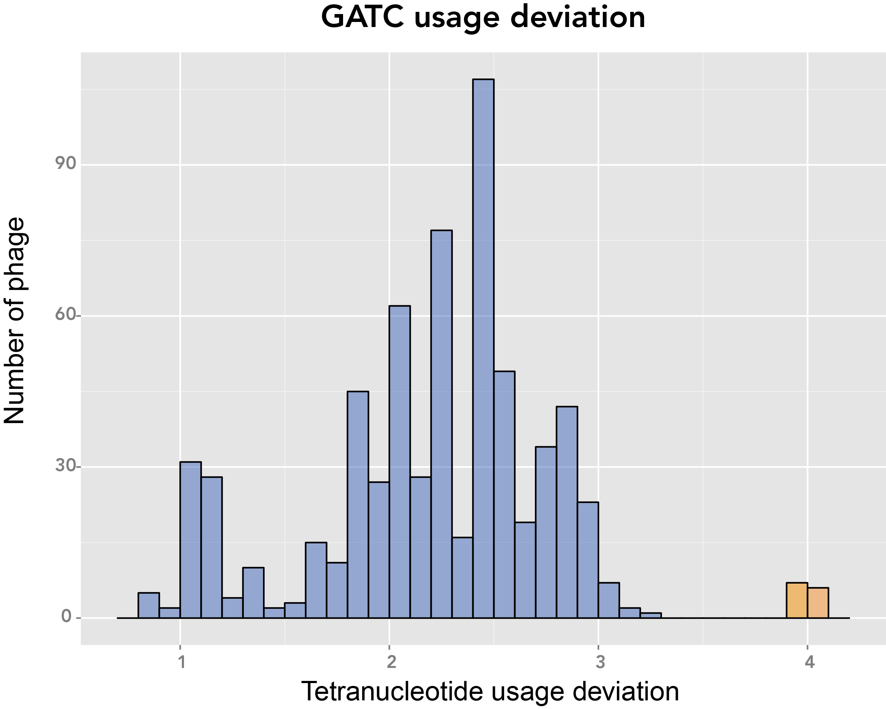
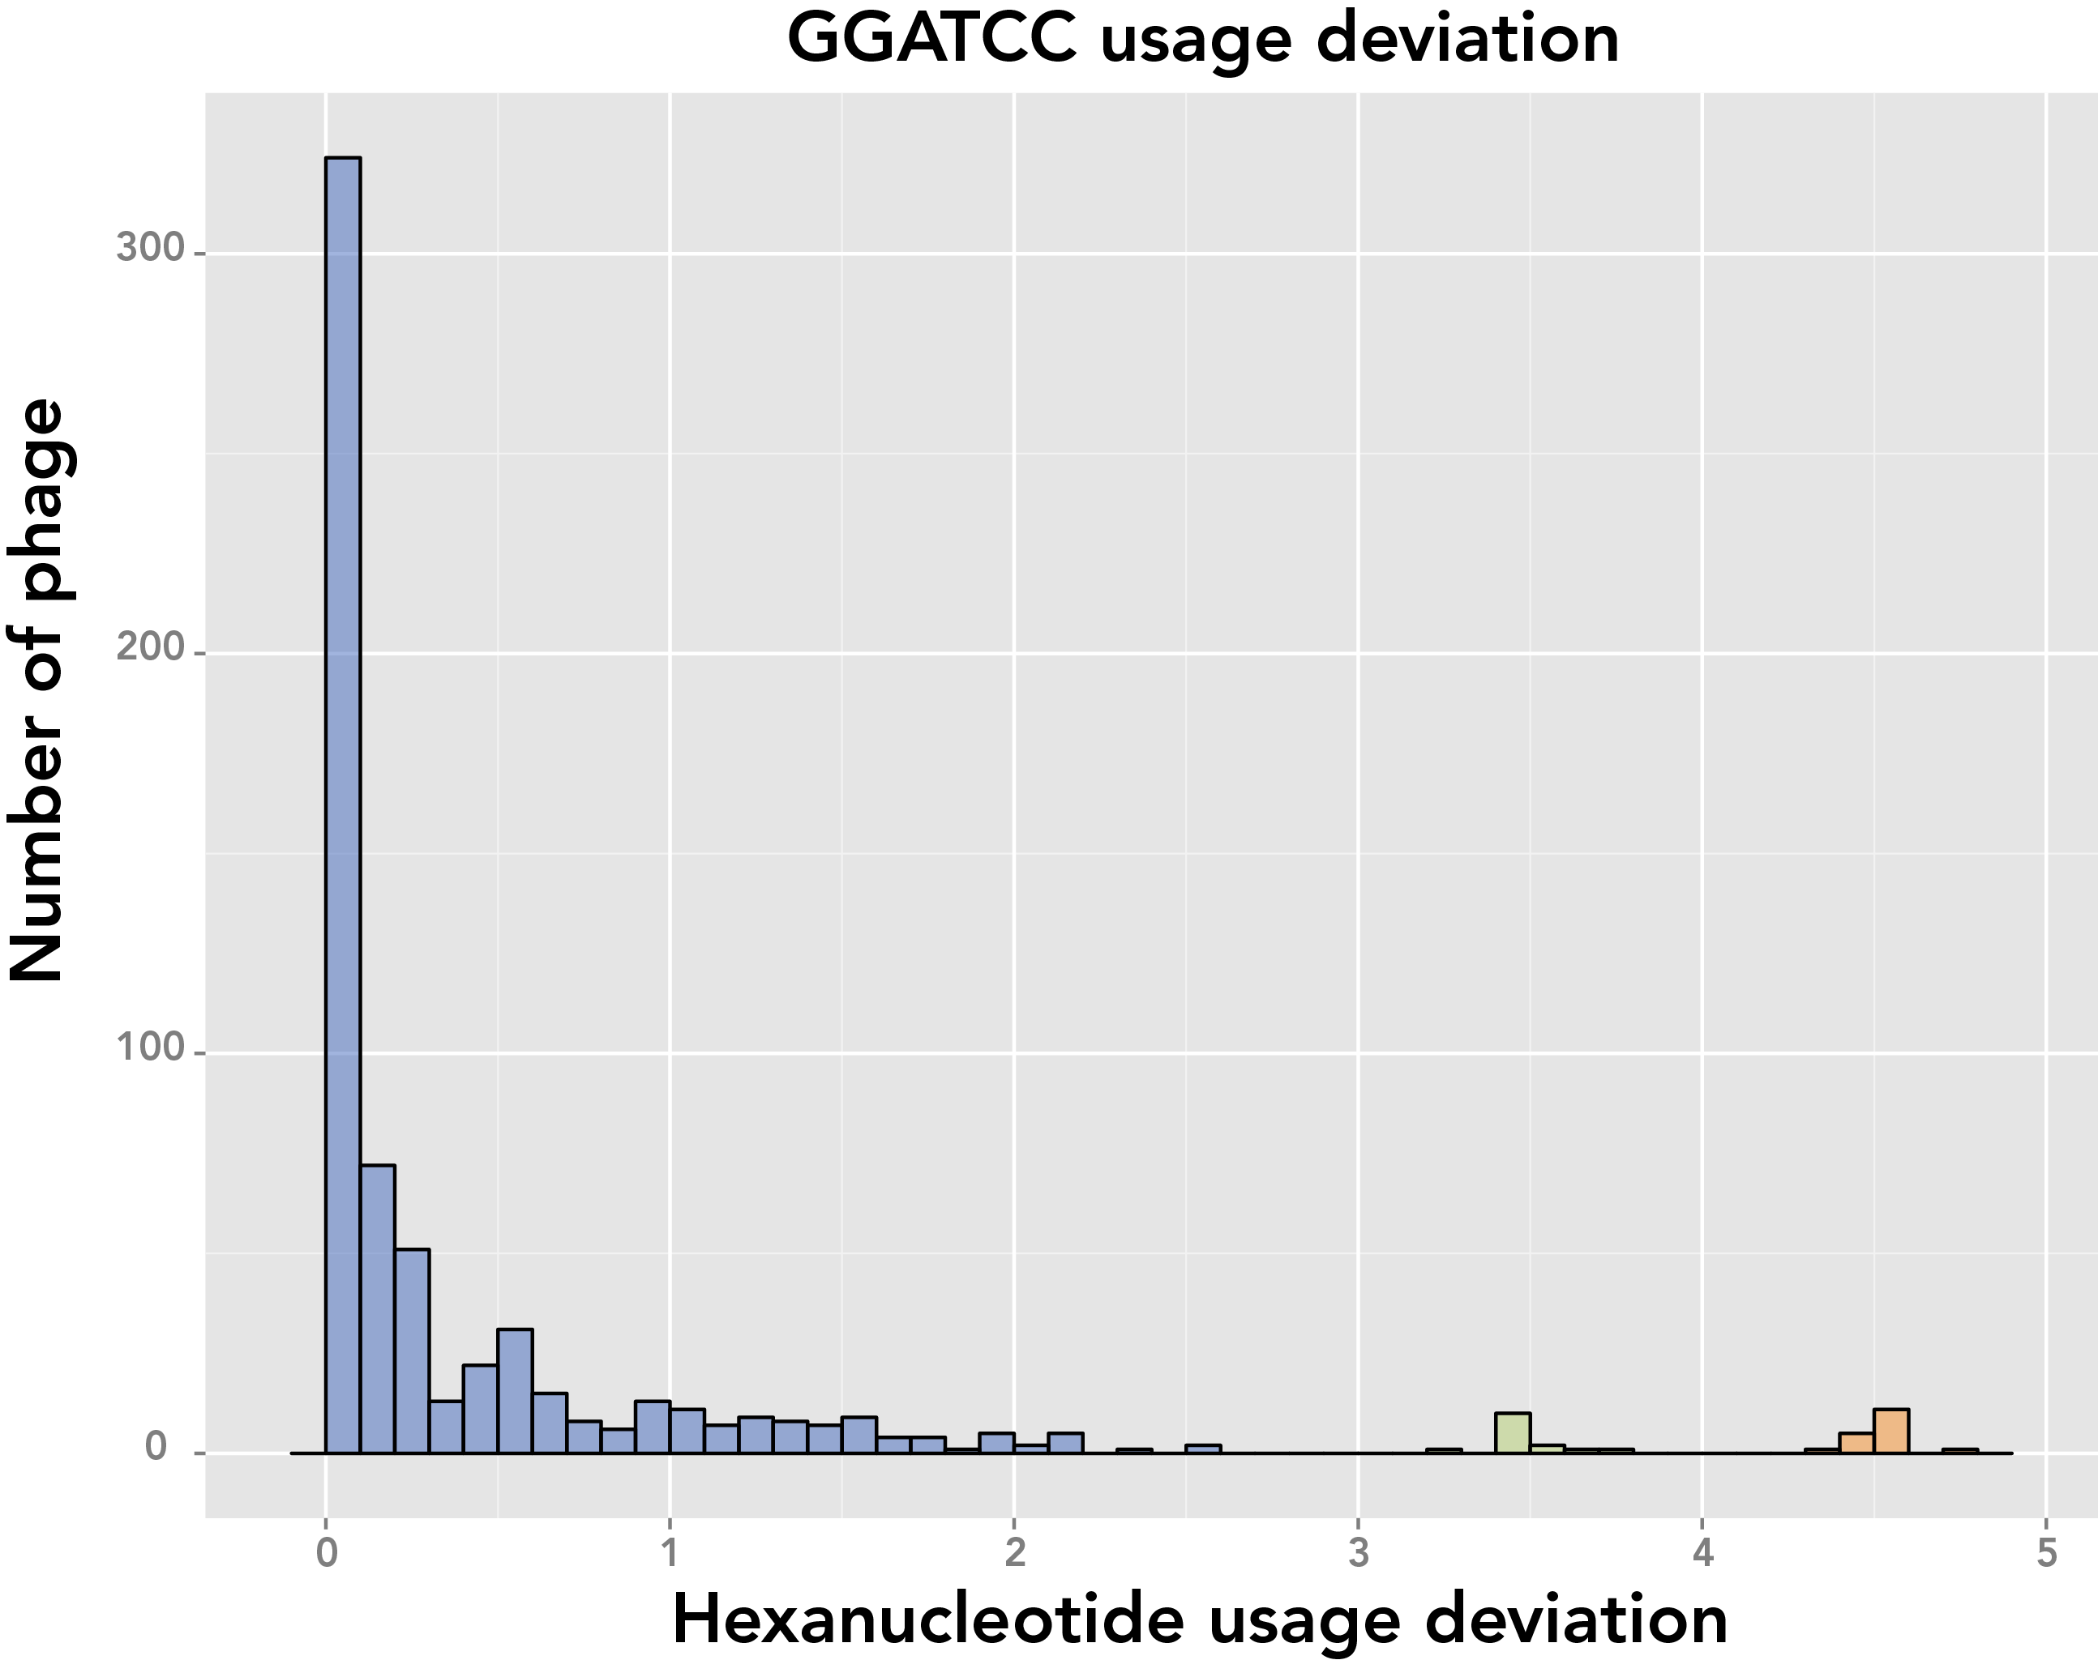
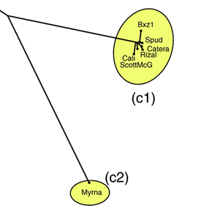
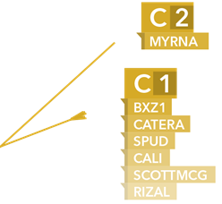
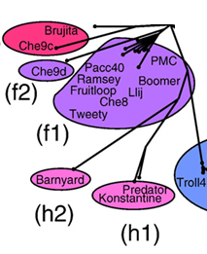
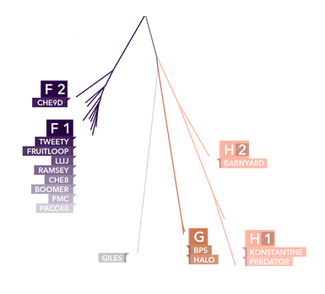


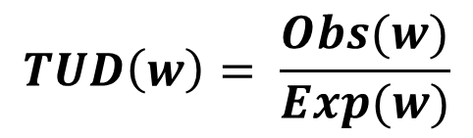
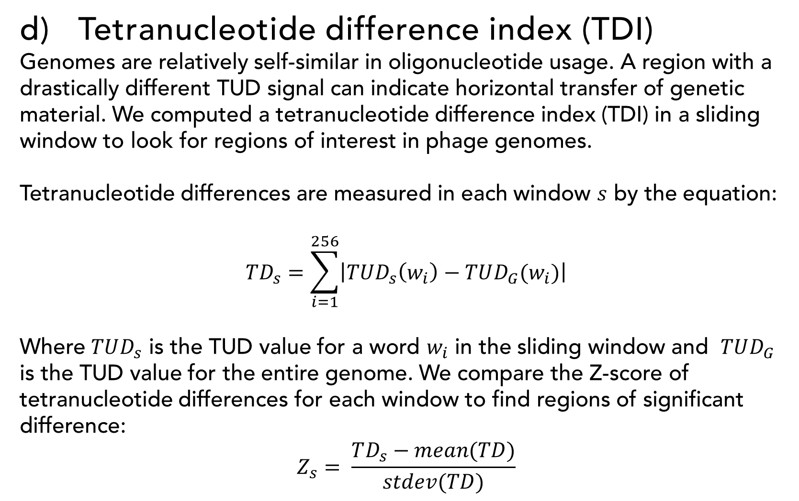
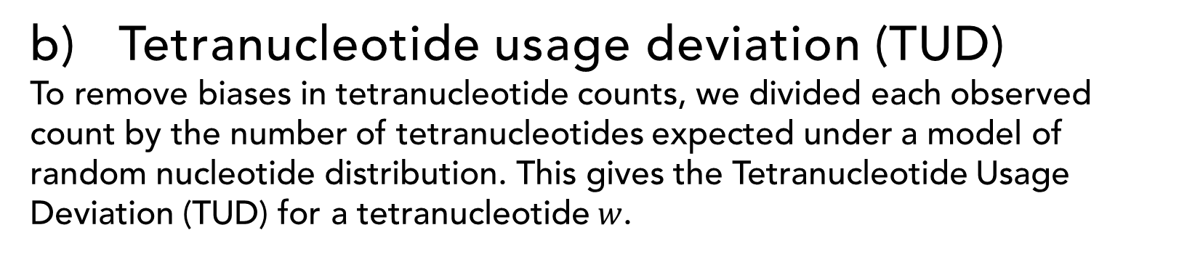
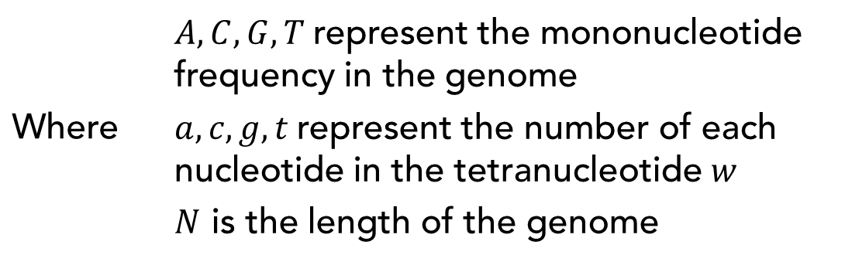
Tetranucleotide usage in mycobacteriophage genomes alignment-free methods to cluster phage and infer evolutionary relationships Chen Ye, Benjamin Siranosian, Emma Herold, Minjae Kwon, Sudheesha Perera, Edward Williams, Sarah Taylor, Christopher de Graffenried
Introduction
Phylogenetic trees and cluster B3
Traditionally, phage genomes are compared using methods that require sequence alignment or gene annotation. These methods may be ineffective for populations with significant horizontal gene transfer and are relatively difficult to compute for large datasets. Mycobacteriophages also lack a common genetic element, like ribosomal RNA in bacteria, from which to compute phylogenetic relationships. Alignment-free sequence analysis methods, such as measures that compute the usage of oligonucleotides in a genome, have the potential to infer relationships between significantly diverged sequences. We examined the usage of tetranucleotides in all 663 phage genomes available in the mycobacteriophage database as an alternative to alignment and annotation based methods.
We found tetranucleotide usage deviation (TUD), a normalized measure of tetranucleotide usage in a genome, to be comparable for members of the same phage subcluster and distinct between subclusters. We used TUD as a measure of distance between phage and were able to:
Construct phylogenetic trees that place members of a subcluster in a monophyletic clade
Accurately assign subclusters to phage in a nearest neighbor classifier
Identify windows in a genome with significantly different tetranucleotide usage, possibly indicating horizontal gene transfer
Cluster B3 phage aren’t closely related to other members of cluster B. We investigated what specific tetranucleotides are responsible for this.
GGATCC
CCTAGG
That’s a BamHI restriction site!
Alignment based tree in Hatfull et. al (2010)
Our TUD based tree
Methods
Kmer counting
We first counted the number of each tetranucleotide in all phage genomes using a sliding window of size 4
Conclusions
GATGATGATCA
GATGATGATCA
GATGATGATCA
GATGATGATCA
GATGATGATCA
Tetranucleotide usage deviation and other alignment-free methods can investigate relationships within the diverse mycobacteriophage population. TUD accurately reconstructs phylogenetic trees and can highlight regions of particular interest in a genome. These methods can be applied in a high-throughput manner, take very small amounts of computational time, and serve as an excellent first pass in the comparative analysis of a mycobacteriophage genome. With some further work we hope to see these methods applied to every new phage sequence.
Here’s the result
GATG | x2
ATGA | x2
TGAT | x1
Tetranucleotide usage deviation (TUD)
To remove biases in tetranucleotide counts, we divided each observed count by the number of tetranucleotides expected under a model of random nucleotide distribution. This gives the Tetranucleotide Usage Deviation (TUD) for a tetranucleotide $w$.
Neighbor joining tree from TUD distance
Future directions
Horizontal gene transfer
A naïve Bayesian classifier can use oligonucleotide counts to calculate the probability of a subsequence originating in a given genome. This can be used to find the most likely genome of origin for a possible HGT event. We plan to implement a naïve Bayesian classifier and further investigate leads uncovered with TDI.
Host-parasite coevolution
Hosts and parasites have similar oligonucleotide usage profiles. We will use data available on phage host preference to investigate this point further.
$$TUD\left(w\right)= \frac{Obs(w)}{Exp(w)}$$
Genomic self-similarity
Evidence of horizontal gene transfer?
$$Exp\left(W\right)= \left[\left(A^{a}∗C^{c}∗G^{g}∗T^{t}\right) ∗N−3\right]$$
Some homology
Where | $A,C,G,T$represent the mononucleotide frequency in the genome $a,c,g,t$represent the number of each nucleotide in the tetranucleotide $w$ $N$ is the length of the genome
JoeDirt gp 130
Mycobacterium abscessus E = 2e-48
Flavobacterium psychrophilum E=2e-28
Opitutaceae bacterium TAV1 ATPase E = 1e-23
Investigate with
Additional information:
Source code and processed data is available at
Github.com/bsiranosian/tango
Bsiranosian.com
The TUD signal for a genome is a vector of 4⁴ = 256 values – one for each possible tetranucleotide
Phamerator
BLAST
Tetranucleotide difference index (TDI)
Genomes are relatively self-similar in oligonucleotide usage. A region with a drastically different TUD signal can indicate horizontal transfer of genetic material. We computed a tetranucleotide difference index (TDI) in a sliding window to look for regions of interest in phage genomes.
Tetranucleotide differences are measured in each window $s$ by the equation:
$$TD_{s}=\sum_{i=1}^{256}{\left|TUD_{s}\left(w_{i}\right)−TUD_{G}(w_{i})\right|}$$
Where $TUD_{s}$ is the TUD value for a word $w_{i}$ in the sliding window and $TUD_{G}$ is the TUD value for the entire genome. We compare the Z-score of tetranucleotide differences for each window to find regions of significant difference:
$$Z_{s}= \frac{TD_{s}−mean(TD)}{stdev(TD)}$$
Literature Cited
Betley, J. N., Frith, M. C., Graber, J. H., Choo, S. & Deshler, J. O. A ubiquitous and conserved signal for RNA localization in chordates. Curr. Biol. 12, 1756–1761 (2002).
Hall, M. et al. The WEKA Data Mining Software: An Update. SIGKDD Explor. f. 11, 10–18 (2009).
Hatfull, G. F. et al. Comparative Genomic Analysis of 60 Mycobacteriophage Genomes: Genome Clustering, Gene Acquisition, and Gene Size. Journal of Molecular Biology 397, 119–143 (2010).
Sandberg, R. et al. Capturing Whole-Genome Characteristics in Short Sequences Using a Na?ve Bayesian Classifier. Genome Res 11, 1404–1409 (2001).
Pride, D. T., Wassenaar, T. M., Ghose, C. & Blaser, M. J. Evidence of host-virus co-evolution in tetranucleotide usage patterns of bacteriophages and eukaryotic viruses. BMC Genomics 7, 8 (2006).
More likely:
JoeDirt (L1) cluster of repeats at 70kb
Archie (L2) cluster of repeats at 74kb and 76kb
Cluster L genomes are very repetitive at the end.
Repetitive regions have increased counts of specific 4-mers, contributing to the spike in TDI.
70000
74000
76000
Acknowledgements
We are grateful to Dr. Peter Shank, Dr. Sorin Istrail, Dr. Zhijin Wu, HHMI’s SEA program and the University of Pittsburgh.
Colored lines indicate significant clusters of repeats
Colored lines indicate significant clusters of repeats

